Slide 1
Analysing Emergency 911 Calls
By: Hirotaka Fujii, Sindhuja Satheesh Kumar, George Jiang
Notes:
George

Slide 2
Problem Statement and Backstory
Problem Statement: Extract meaningful information and detect a pattern from Emergency 911 call dataset.
Backstory: Since coming to BU, we have consistently heard ambulance sirens especially at night. That inspired us to explore a 911 data set and learn as much information we could from this project.
Notes:
George

Slide 3
Missing Zip Codes
We ended up using Zip Codes as a point of organization for our Statistical Tests.
However, due to missing data, we used a KNN Algorithm to fill in the gaps, using Latitude, Longitude, and a hashed Township Name as features.
Notes:
Hiro

Slide 4
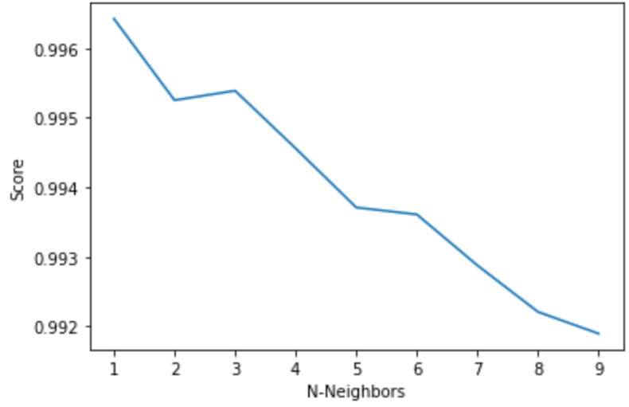
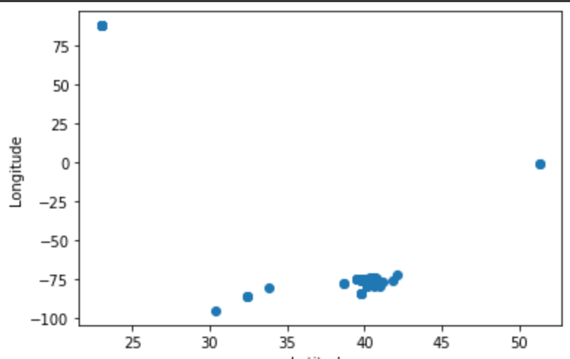
Missing Zip Codes
Going to include graphs
Notes:
Hiro

Slide 5
Methods (Statistics)
2 sample proportion z-test & chi-square test
Compared proportion of EMS 911 calls from zip codes 19401 and 19403 → z-test showed that overall the proportion was different (p-value = 0)
When split by morning, afternoon, and evening, the proportion of EMS calls from the same zip codes were about the same (p-value of 0.000019482, 0.000013801, 0.000002161, respectively)
Actual difference was ~3%
Checked to see if EMS calls were evenly distributed throughout the morning, afternoon, and evening through chi-square test → not evenly distributed (p-value = 0)
Notes:
George

Slide 6
Methods (Statistics + Visualization)
Built a Regression Model to find the relationship between the hour of day 911 calls were made and the number of townships that made the calls; also to interpolate call count
Evaluated the model using R-Squared score
Produced a word cloud on reasons for 911 calls for preliminary data exploration
Created 3 bar charts to visualize the number of calls per day, per month, and per year over the span of 6 years (2015-2020) - meant for preliminary data exploration
Generated a faceted histogram using Seaborn to visualize the count of all 911 calls for each township based on the year (rows) and type of 911 call being either EMS, Fire, or Traffic (columns)
This was meant to observe the distribution of calls for each township over the 6 years which would later aid in geolocation visualization
Notes:
Sindhuja

Slide 7
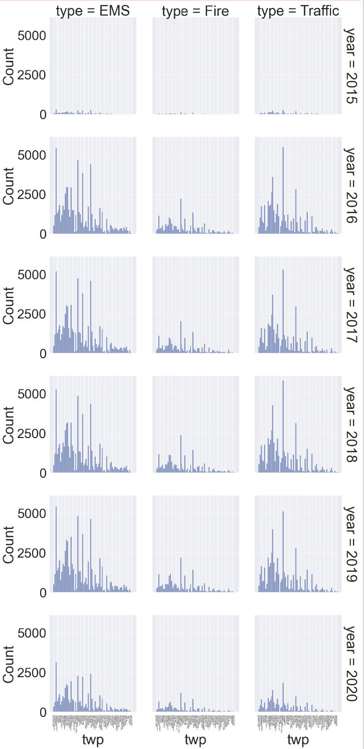
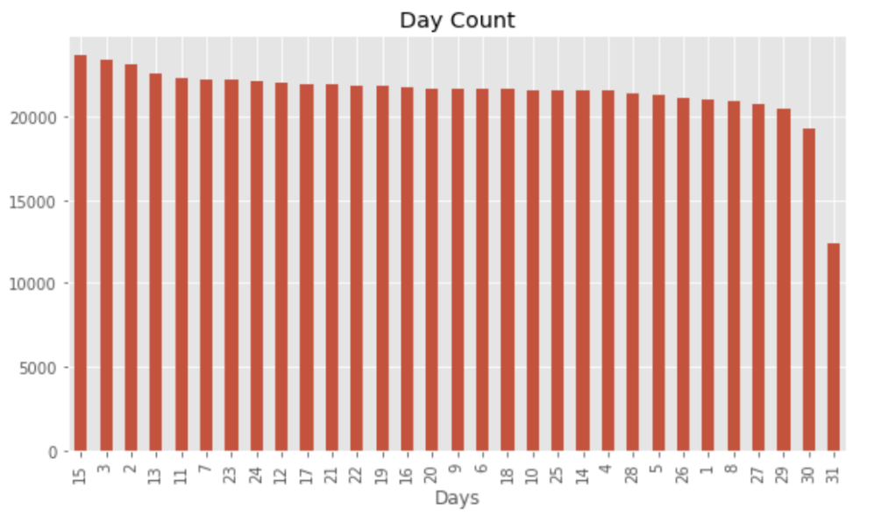
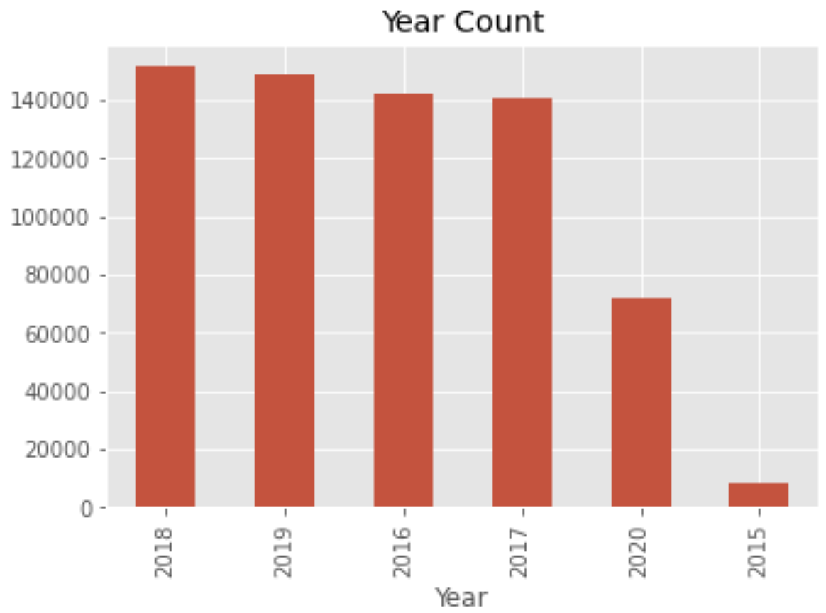
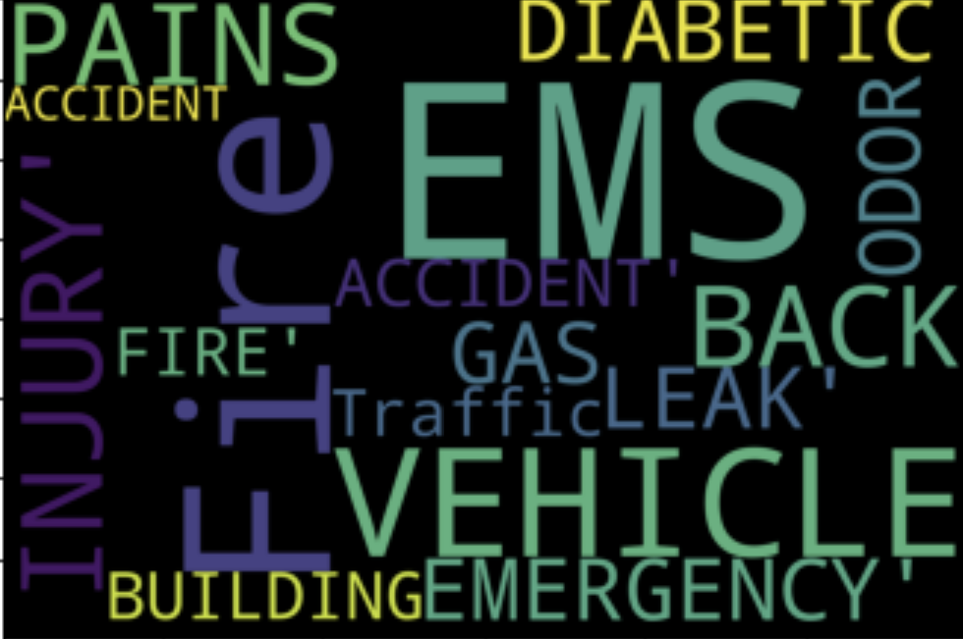
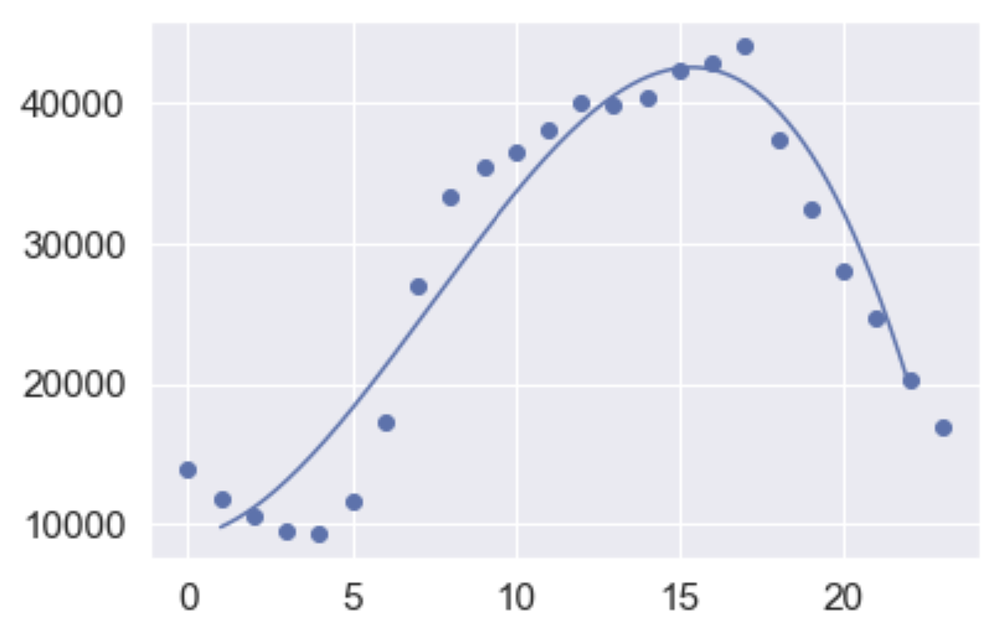

Slide 8
Challenge
The dataset was extremely large and processing the models took a very long time.
Notes:
Hiro

Slide 9
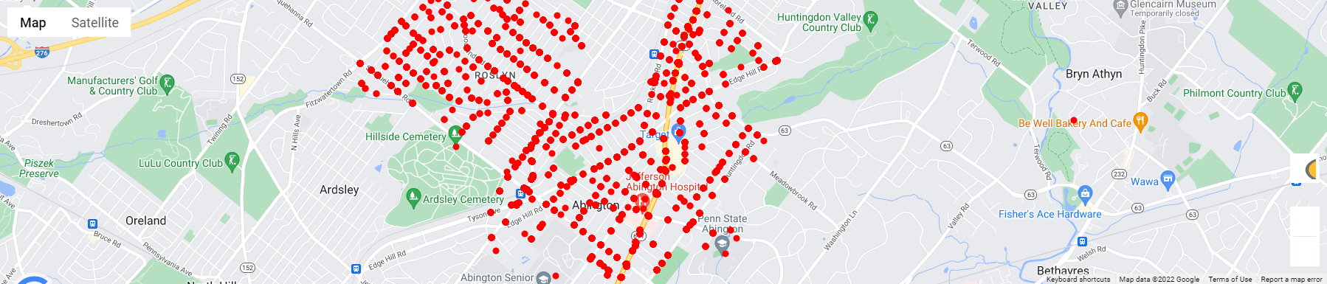
Results
Notes:
Hiro

Slide 10
Conclusion
The polynomial regression model, with a 0.92 R² score, showcases a strong relationship and has a great data fit where the peak hour of 911 calls is 1500 hours (03:00 pm) with 42,263 calls from 2015-2020.
The overall proportion of EMS calls between the two zip codes is different, and when compared to different times of day, they are still the same
Notes:
Sindhuja

Slide 11
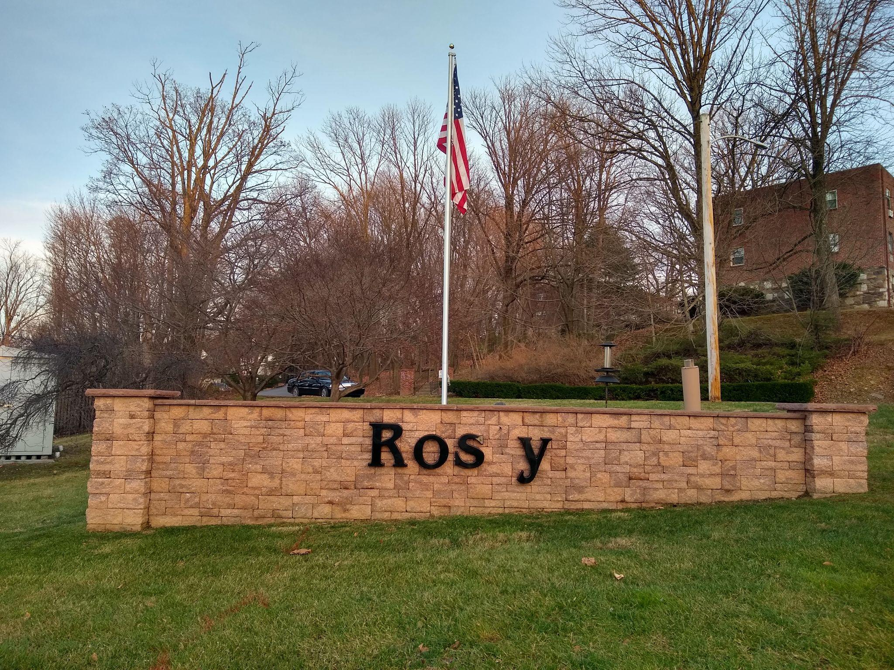
Fun Fact
This is actually the county that I’m from! - Hiro
Notes:
Hiro

